Slide 1
Introduction:
The microprocessor is the brain of any normal computer .
The microprocessor you are using might be a Pentium, AMD , a PowerPC, a Sun-SPARC or any of the many other brands and types of microprocessors.

Slide 2
Micro processor
Microprocessor is a multi purpose programmable logic device that reads binary instruction from a storage device memory accept binary data as input and processes the instruction for execution

Slide 3
Microprocessor History
Intel coined the term ‘MICROPROCESSOR’ and in 1971 released the first 4-bit microprocessor as the 4004 having 2300 transistors,640 bytes of memory addressing capacity and a 108 kHz clock speed.
The 4004 was not very powerful -- all it could do was add and subtract, and it could only do that 4 bits at a time .The 4004 powered one of the first portable electronic calculators.

Slide 4
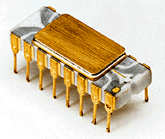
Intel 4004
The Intel 4004 was a 4-bit central processing unit (CPU) released by Intel Corporation in 1971. It was the first complete CPU on one chip, and also the first commercially available microprocessor.

Slide 5
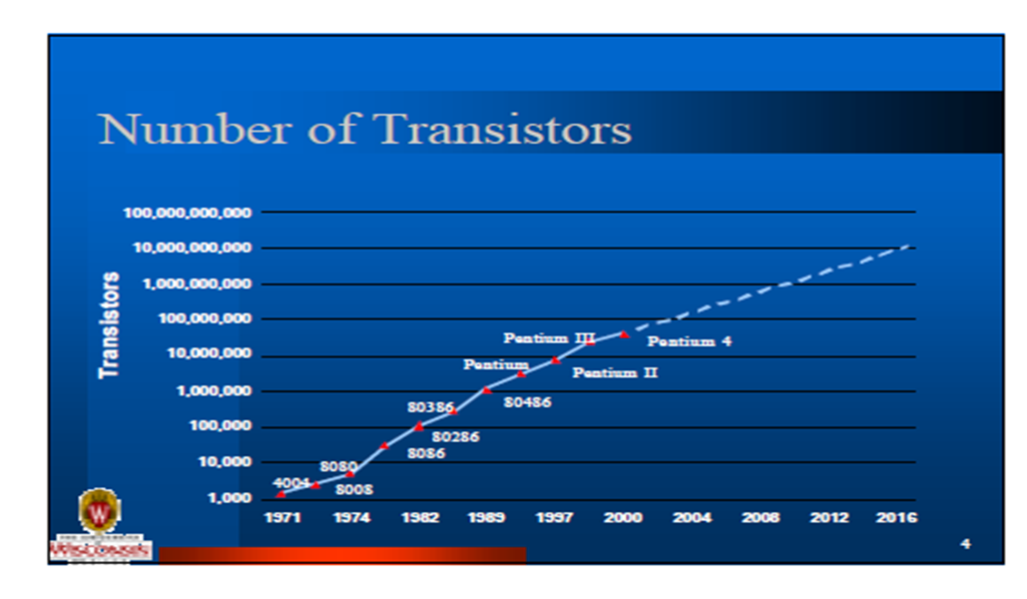

Slide 6
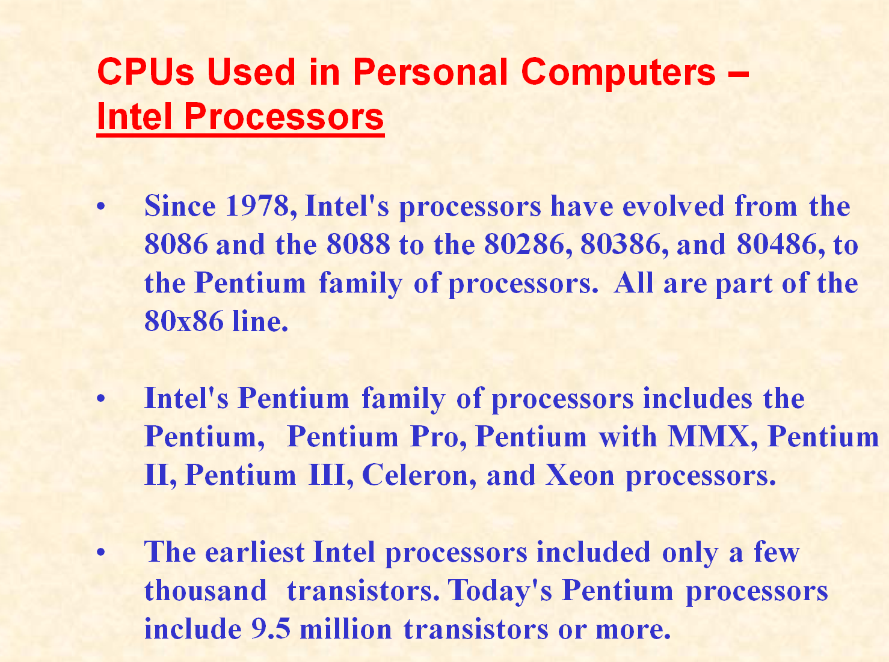

Slide 7
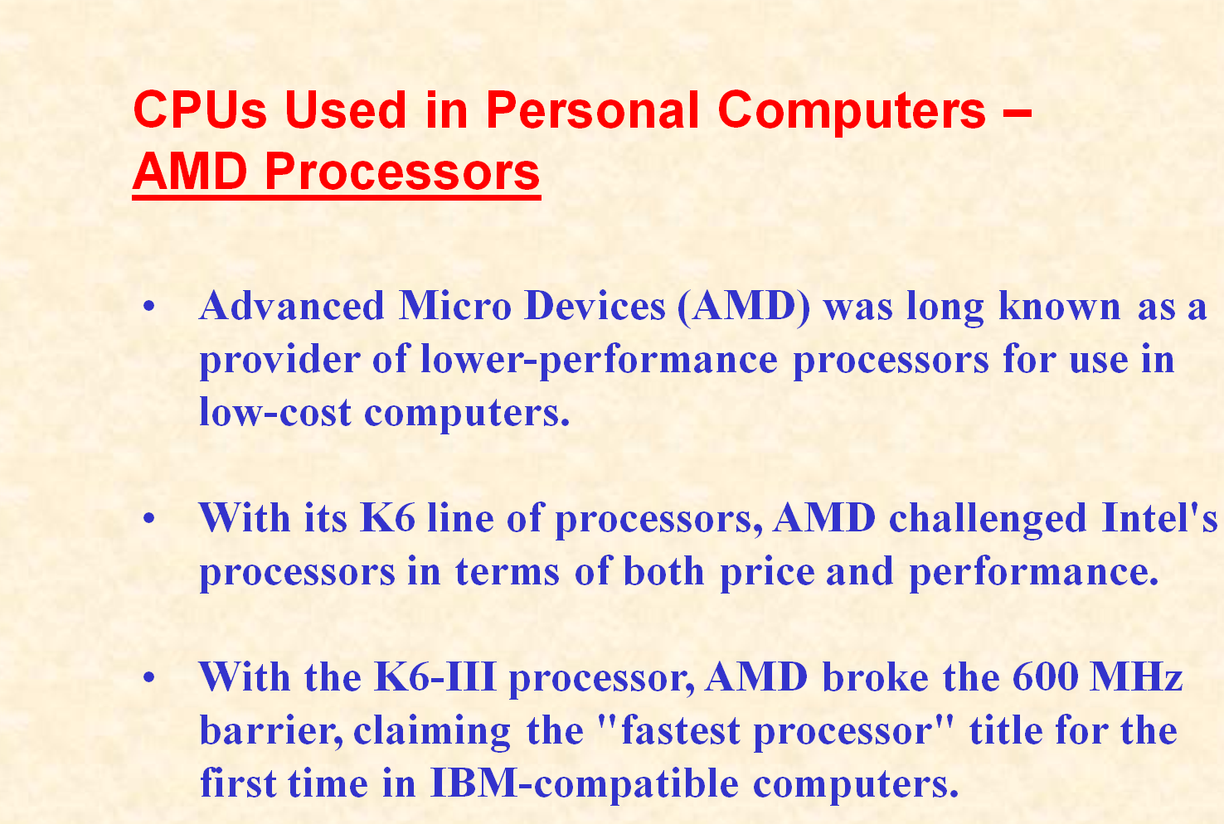

Slide 8
